Slide 1
uW Hackathon – 2024
Audio is a primary part of the human/computer interaction requried for Oral Bible Translation (OBT). And some Bible translation efforts target "low resource languages". As such, Bible translation software must understand spoken audio from low resource languages.
Thesis: Find a stable method for recognizing individual words in low-resource languages.
Here, we propose a model to recognize individual spoken words in Dholuo.
Definitions:
Here, "low resource languages" is understood as any language that does not have open, available models for LLM, speech-to-text, and text-to-speech.
By requiring a "stable" model, we require the solution to be independent of tone, volume, speed, or the speaker's gender.

Slide 2
uW Hackathon – 2024
Method:
Python packages:
- librosa Encoding audio data
Collect the Data
Clean the Data
Explore/Visualize the Data

Slide 3
Collect the Data

Slide 4
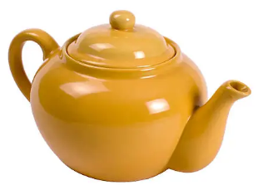

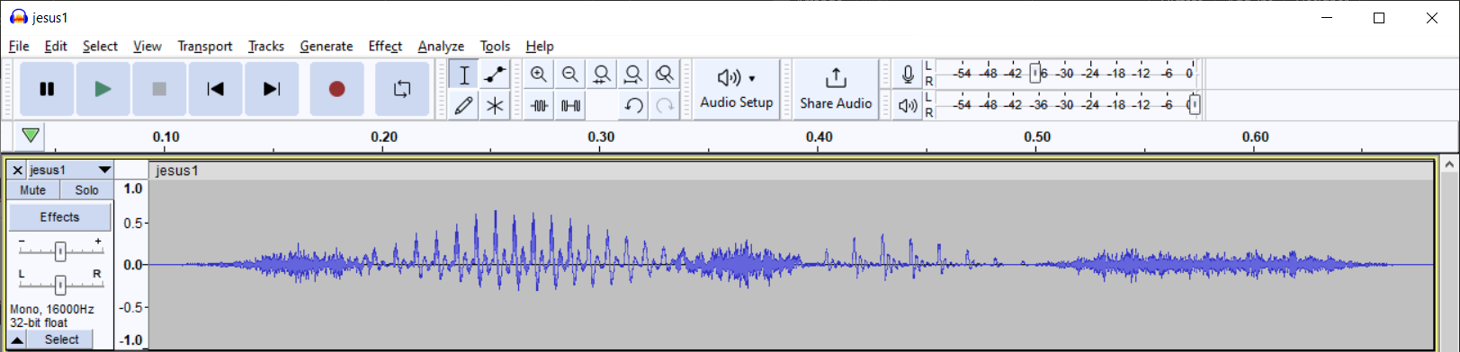
Clean the Data
< 5.3, 3.2, 4, … >

Slide 5
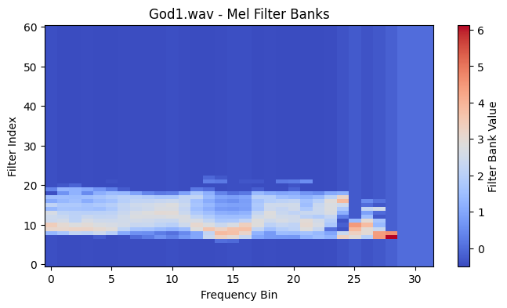
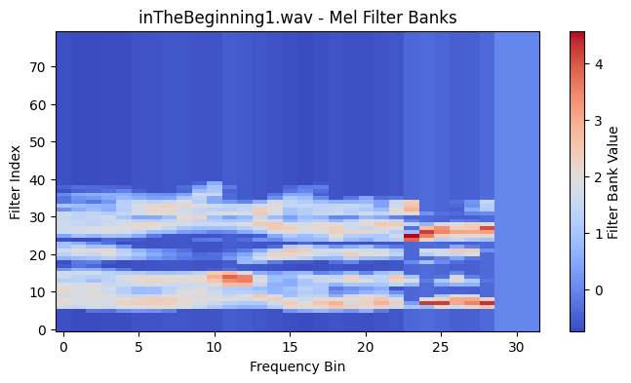
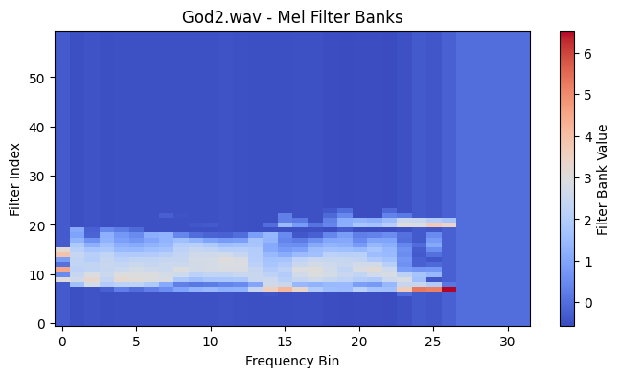
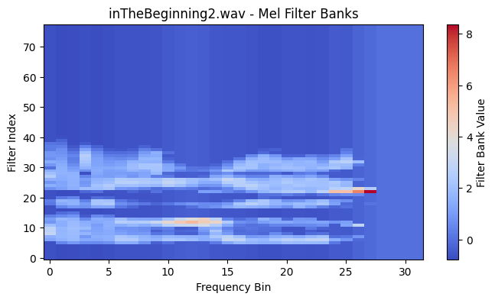
Explore/Visualize the Data

Slide 6
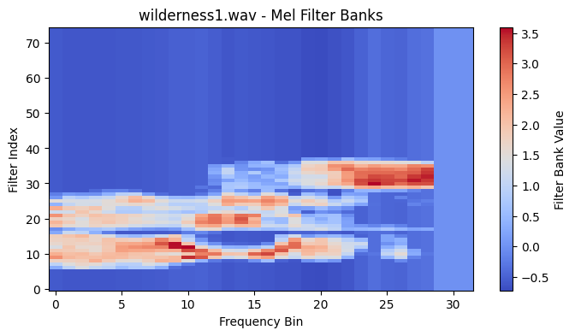
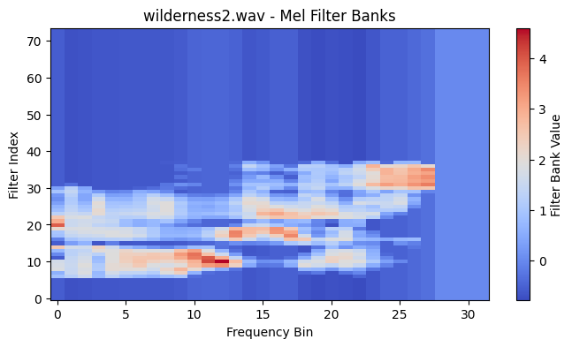
Explore/Visualize the Data

Slide 7
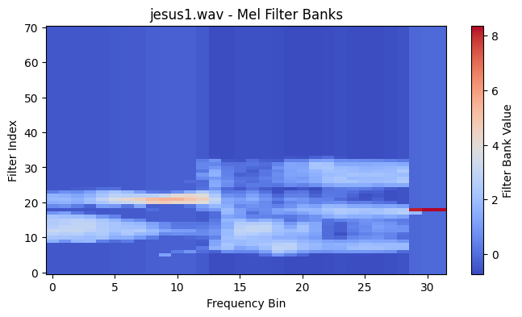
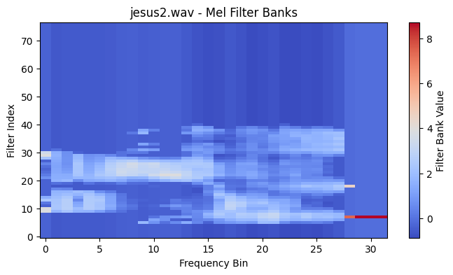
Explore/Visualize the Data

Slide 8
Off-the-Shelf Solution
We can compare to an off-the-shelf solution (`librosa` mfcc feature extraction):
This solution correctly identifies the correct forms, but it does not detect as much difference between the incorrect forms.
For keyword checking, it might be helpful to have a meaningful measure of how different the words are:
No clustering!
Similar to wilderness1.wav:
wilderness1.wav: 0.9999999869496023
wilderness2.wav: 0.9993146675340262
God1.wav: 0.9987559253705995
God2.wav: 0.9980986833151937
inTheBeginning1.wav: 0.9971207291637255
inTheBeginning2.wav: 0.9969806586039947
jesus2.wav: 0.9958133114595762
jesus1.wav: 0.9942425674771389

Slide 9
Report:
Similar to wilderness1.wav:
wilderness1.wav: 1
wilderness2.wav: 0.7229432647124682
jesus2.wav: 0.3134769071964211
God1.wav: 0.23680512842732715
jesus1.wav: 0.21231795463558845
God2.wav: 0.1635381466180469

Slide 10
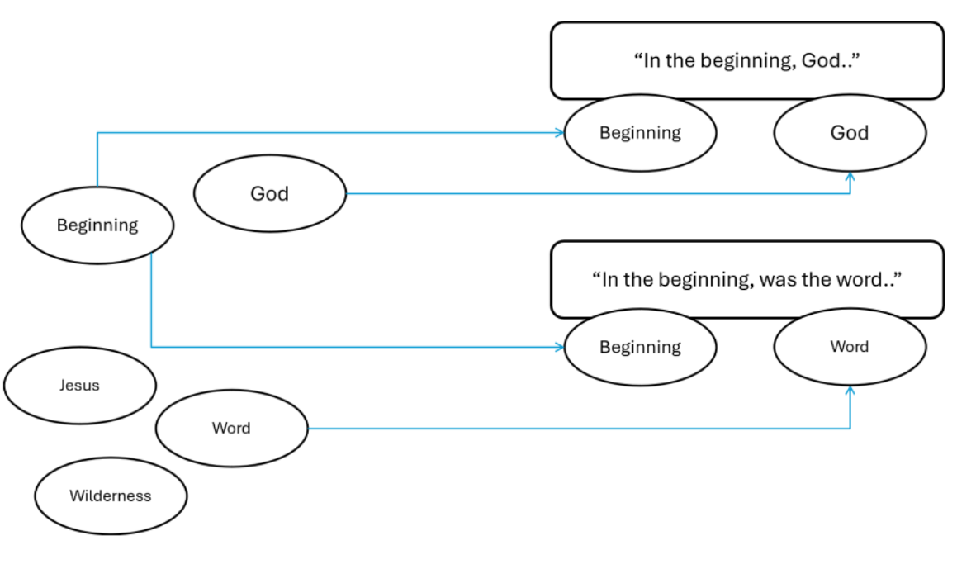
Application
Keyword checking

